Slide 1
Week 5 Notes
PHY495: Hoop Never Misses

Slide 2
What I’ve Done
Created monte_carlo.py file where I find, for a single shot, the percent of random shots that make it in the backboard
Spent some time double checking the velocities of the ball after hitting the angled backboard
Made a percent_in function that solves for the percent of random (I was mainly using predetermined shots for now though) shots that goes into the basket for a given backboard angle
Made a best_angle function that compares different backboard angles stored in array to see which angle causes the most random shots to go in the basket

Slide 3
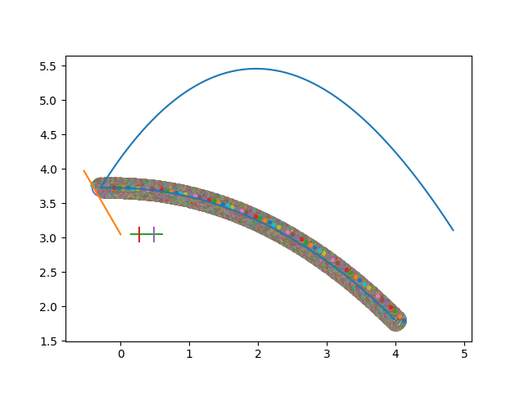
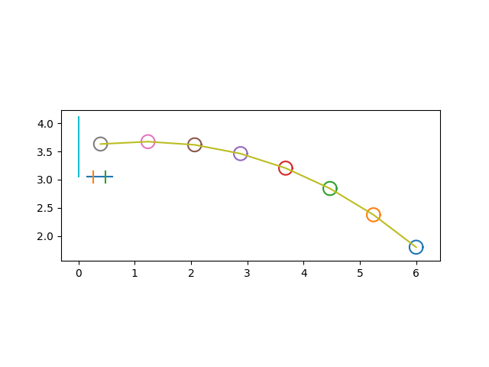
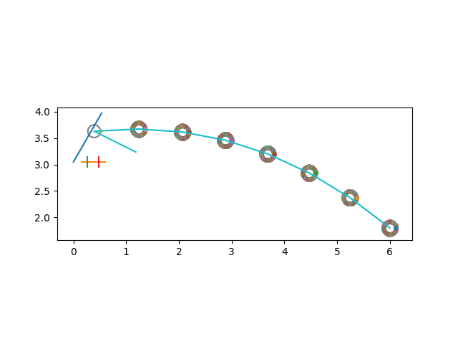
What Worked
Plotted shots hitting the backboard for different specified backboard angles
Phi=2*np.pi/3
Phi=np.pi/2
Phi=np.pi/3

Slide 4
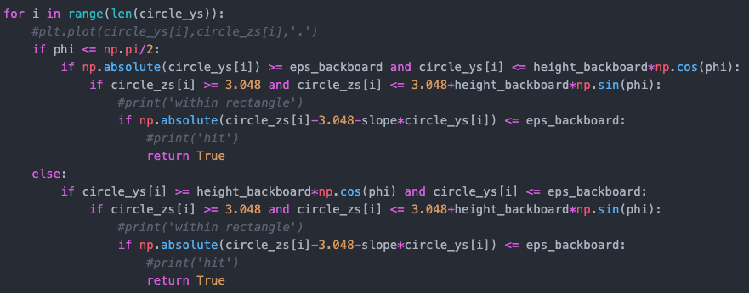
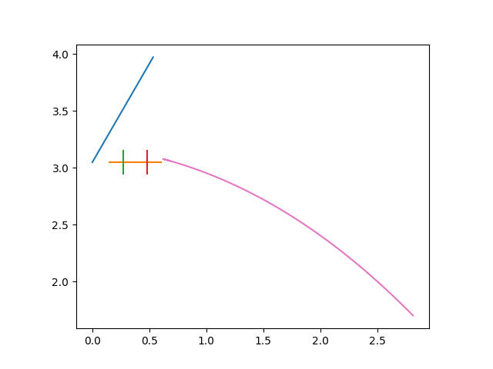
What Worked
I found that my conditions of whether the ball hit the backboard showed whether the ball was in the rectangular region of the backboard, so the code was either stopping too early or going too far. So I had to add the equation of the line to the code.

Slide 5
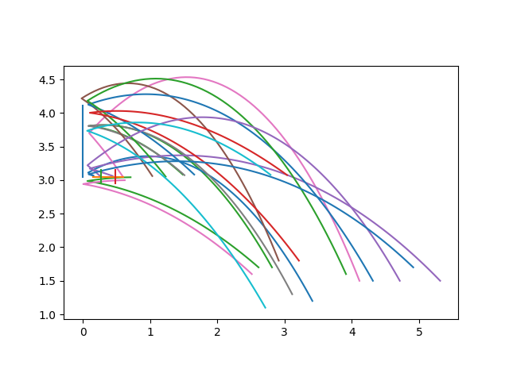
What Worked
For a given backboard angle, plotted all random shots that hit the backboard

Slide 6
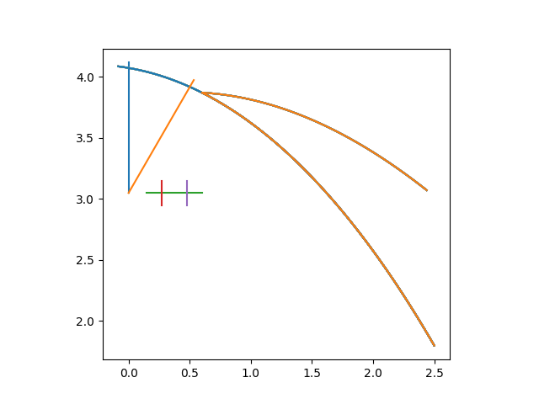
What Didn’t Work
In the best_angle function I started by only comparing np.pi/3 and np.pi/2
I chose the initial conditions and the shot didn’t go in for either backboard. Notice how the np.pi/3 backboard shot rebounds, as expected. The np.pi/2 backboard shot doesn’t rebound even though the ball hits the backboard.
I don’t have a specific question here but will have to spend some time myself debugging this.

Slide 7
What Didn’t Work
My velocities after hitting the angled backboards were initially wrong but I fixed it
Various problems in the code that I had to debug

Slide 8
Where am I Stuck
Don’t have anything specific as of now!

Slide 9
What Next?
Energy lost in collision with backboard
Run best_angle function more
With a greater number of shots to get a better sense of, out of pi/2 and pi/3 (which are the two angles I’m currently comparing), which angle is more optimal
With a larger array of angles to compare more angles
Optimize backboard angle – solve for the best angle out of a large range of angles then hone in on the optimum angle until we get convergence
Implement random sampling of backboard angles

Slide 10
Sources

